Slide 1
3.3 Data storage
Secondary storage

Slide 2

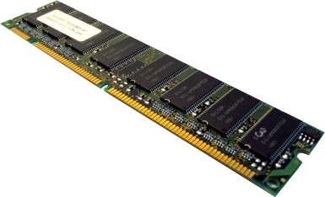
Secondary storage
Primary storage
RAM, ROM, registers and cache

Slide 3
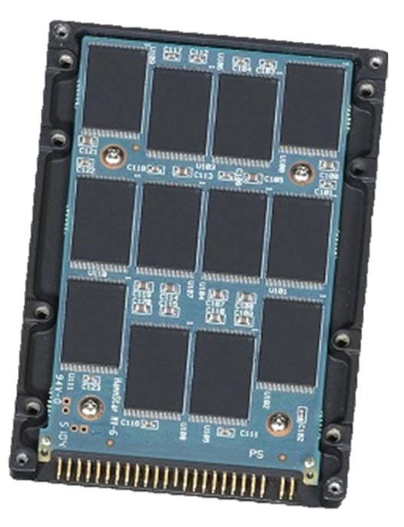
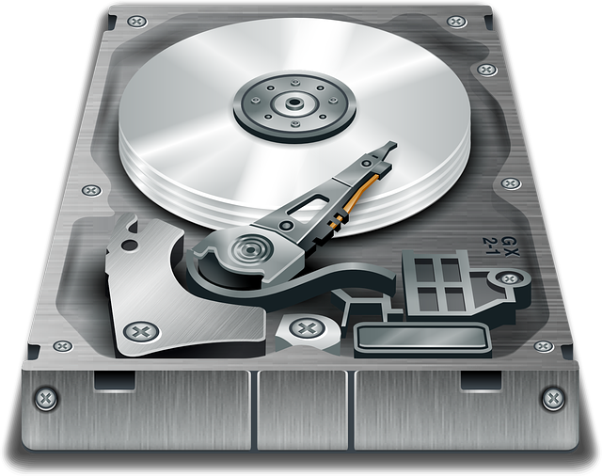
Secondary storage
Primary storage
Secondary storage
RAM, ROM, registers and cache
Holds the operating system, programs and data when they are not in use

Slide 4
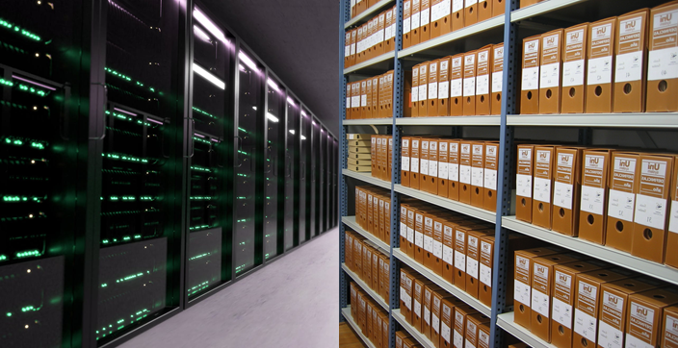
Secondary storage
Primary storage
Secondary storage
Tertiary storage
RAM, ROM, registers and cache
Holds the operating system, programs and data when they are not in use
Used for backing up and archiving large amounts of data

Slide 5





Secondary storage
ROM
CPU
RAM
Hard drive

Slide 6
Secondary storage
ROM
CPU
RAM
Hard drive

Slide 7
Secondary storage
ROM
CPU
RAM
Hard drive

Slide 8
Secondary storage
ROM
CPU
RAM
Hard drive
Non-volatile
Read and write

Slide 9

Secondary storage
Secondary storage is required because ROM is read-only and RAM is volatile. Secondary storage is used for:
Storage of programs and data when the computer is powered off.
Modifiable, semi-permanent storage of data.
Backing up or archiving data.

Slide 10


